Slide 1
Skewness and Kurtosis

Slide 2
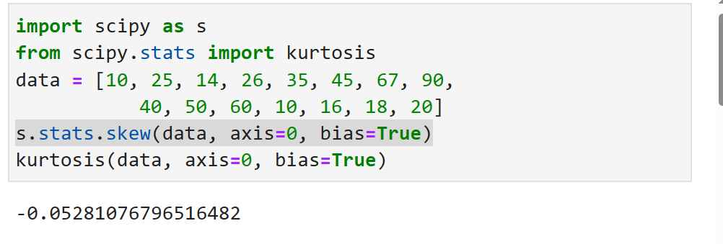

Slide 3
Skewness is a statistical term and it is a way to estimate or measure the shape of a distribution. It is an important statistical methodology that is used to estimate the asymmetrical behavior rather than computing frequency distribution. Skewness can be two types:
Symmetrical: A distribution can be called symmetric if it appears the same from the left and right from the center point.
Asymmetrical: A distribution can be called asymmetric if it doesn’t appear the same from the left and right from the center point.
Distribution on the basis of skewness value:
Skewness = 0: Then normally distributed.
Skewness > 0: Then more weight in the left tail of the distribution.
Skewness < 0: Then more weight in the right tail of the distribution.

Slide 4
Kurtosis:
It is also a statistical term and an important characteristic of frequency distribution. It determines whether a distribution is heavy-tailed in respect of the normal distribution. It provides information about the shape of a frequency distribution.
kurtosis for normal distribution is equal to 3 : it is called as Mesokurtic
For a distribution having kurtosis < 3: It is called platykurtic
For a distribution having kurtosis > 3, It is called leptokurtic and it signifies that it tries to produce more outliers rather than the normal distribution.

Slide 5
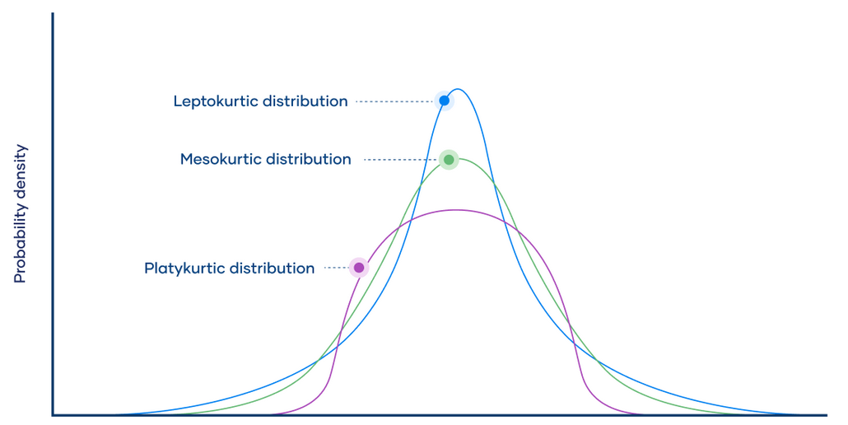

Slide 6
Calculation of skewness and kurtosis
Step 1: Importing SciPy library.
Step 2: Create a dataset.
Step 3 :Computing skewness of the dataset by using skew()function
Syntax:
scipy.stats.skew(array, axis=0, bias=True)
array: It represents the input array (or object) containing elements.
axis: It signifies the axis along which we want to find the skewness value (By default axis = 0).
bias = False: Calculations are corrected to statistical bias.

Slide 7
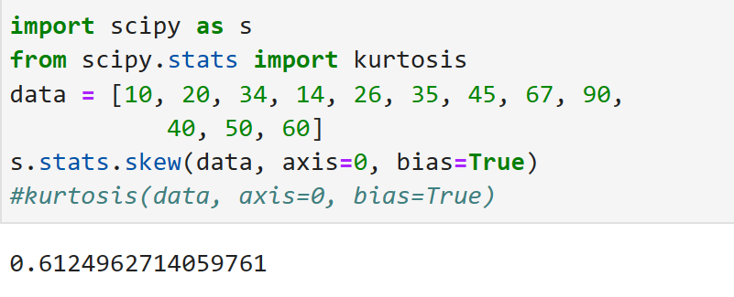

Slide 8
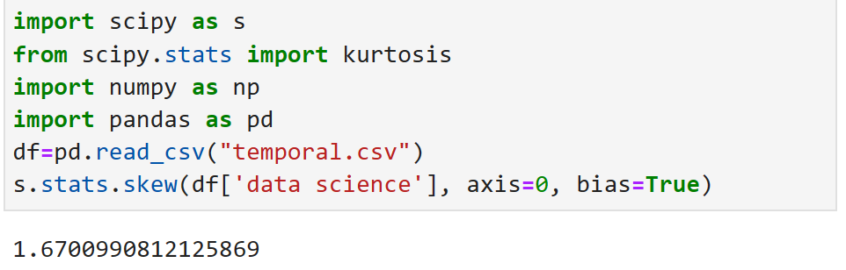
Step 4: Computing kurtosis of the dataset by using kurtosis().
Syntax:
scipy.stats.kurtosis(array, axis=0, fisher=True, bias=True)

Slide 9
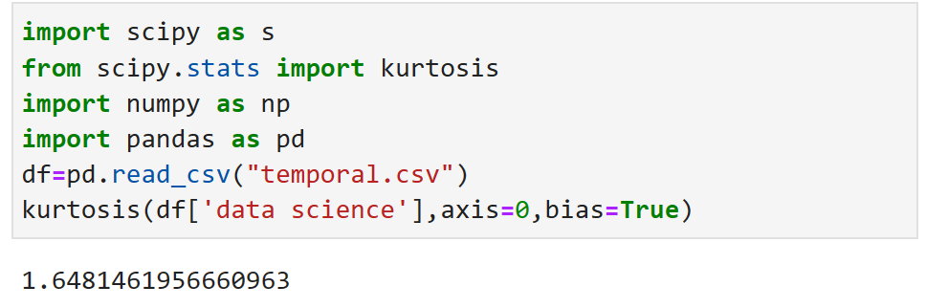

Slide 10
Univariate Analysis
Univariate Analysis is a type of data visualization where we visualize only a single variable at a time. Univariate Analysis helps us to analyze the distribution of the variable present in the data so that we can perform further analysis.
Histplot(df[‘data science’]

Slide 11
Bivariate analysis
Bivariate analysis is the simultaneous analysis of two variables. It explores the concept of the relationship between two variable whether there exists an association and the strength of this association or whether there are differences between two variables and the significance of these differences.

